Slide 1

MEMBER

Slide 2
MEMBER
Project Manager: Orchestrated the project’s workflow and ensured timely delivery.
Lead Developer: Spearheaded the coding efforts, focusing on CSS and JavaScript functionalities.
ANNFAITH KAMAU

Slide 3

INSPIRATION

Slide 4

INSPIRATION
The concept for “Gadget World Stock Taking Management System” emerged from a simple yet universal truth: everyone seeks comfort and joy in the little things. For many, teddy bears are a symbol of childhood innocence, a source of solace, and a silent companion through life’s ups and downs.
The protectors of our childhood secrets and the silent witnesses to our dreams. I realized that these stuffed companions were more than just toys; they were keepers of my most tender moments.
This realization sparked a desire to recreate that sense of safety and affection in the digital realm. I wanted to craft an online experience that encapsulated the essence of a teddy bear’s hug - warm, secure, and loving. “Cuddly Hugs” was envisioned as a portal where anyone, regardless of age or background, could relive the comforting embrace of their furry friends.
I imagined a place where users could not only find a perfect teddy bear but also resonate with their memories and emotions. Each bear in my portfolio is not just a product but a potential lifelong companion, ready to offer a cuddly hugs whenever needed.
As I embarked on this project, my goal was clear: to weave the nostalgic threads of our pasts into a modern tapestry that others could cherish. “Cuddly Hugs” is more than a brand; it’s a heartfelt tribute to the timeless companions who have given us comfort and joy.

Slide 5

TECHNOLOGY
&
ARCHITECTURE

Slide 6
TECHNOLOGY & ARCHITECTURE
HTML (Hyper-Text Markup Language): The backbone of the website, HTML provides the essential structure. I used semantic HTML elements to create a clean, organized content hierarchy, making it accessible and SEO-friendly.
CSS (Cascading Style Sheets): With CSS, I introduced elegance and responsiveness to the design. Utilizing Flexbox and Grid systems, I crafted a fluid layout that adapts to various screen sizes. CSS animations were applied to enhance the user interaction, giving life to button hovers.
JavaScript (JS): JavaScript brought the teddy bears to life. Allowing users to select different colors and sizes of the teddy bear.
Architecture: The architecture is modular, separating concerns for maintainability and scalability. The front end interacts with a RESTful API, fetching data about teddy bears. I ensured cross-browser compatibility and used progressive enhancement strategies to provide a core experience for users with older browsers while enabling richer features for those with modern browsers.

Slide 7

CODE SNIPPET & ALGORITHM

Slide 8

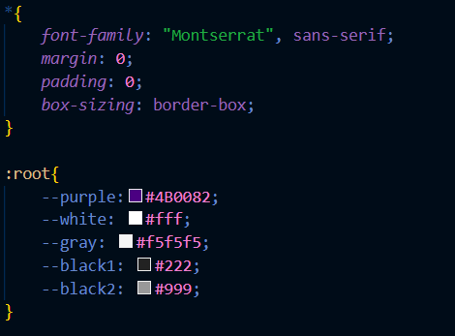
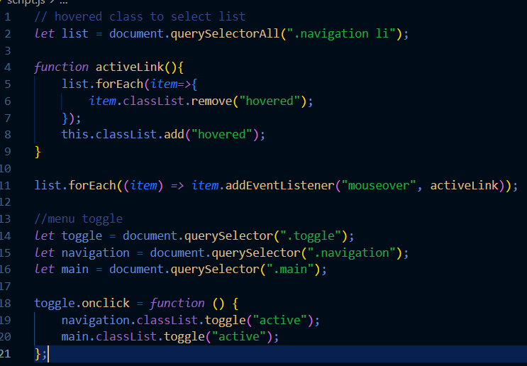
CODE SNIPPET & ALGORITHM
CSS Custom Properties (Variables):
In this snippet, we define some custom properties (variables) to set consistent values for colors, borders, and other styling elements.
In this version:
--main-color represents the primary color used throughout the website.
--purple defines the theme of the store.
--purple and white sets the background color.
--box-sizing specifies a border style.
Interactive Navbar Toggle (JavaScript):
This snippet handles the behavior of a navigation menu when a user clicks a menu button. It toggles the active state of the navigation bar.

Slide 9

PROCESS,
COLLABORATION,
TIMELINE

Slide 10
PROCESS, COLLABORATION, TIMELINE
Timeline:
Month 1: Focused on planning, research, and setting up the project infrastructure. Documenting the various process that will be used as reference in knowing more about the portfolio. This included defining requirements, and setting up the development environment.
Month 2: Dedicated to ensuring mobile responsiveness. Used to refine features, conducted extensive testing, and prepared for launch.
Agile Methodology: This project embraced the agile methodology, which allowed me to adapt quickly to changes and continuously improve the product. I organized the work into two-week sprints, with each sprint resulting in a potentially shippable product increment.
Collaborative Tools:
Git: I used Git as the version control system, hosted on platforms in GitHub. This enabled me to track changes, manage code branches, and collaborate effectively.
This detailed breakdown showcases the structured yet flexible approach I took to develop the “Cuddly Hugs Teddy Bear Portfolio”. It highlights my commitment to collaboration and efficiency.

Slide 11

CHALLENGES

Slide 12
CHALLENGES
Merging GitHub with VS Code: One of the technical challenges I faced was integrating my version control workflow with the development environment. I wanted to streamline the process by merging GitHub repositories directly within Visual Studio Code.
Technical Challenges:
Workflow Optimization: Creating a workflow that allowed for easy pull requests, code reviews, and merges without leaving the VS Code environment.
Developer Experience: Providing a smooth experience for the developer when switching between coding and version control tasks.
Solution:
Implementing User Preferences: Another significant challenge was implementing a system that could adapt to user preferences, providing a personalized experience for each visitor to our “Cuddly Hugs Teddy Bear Portfolio”.
Technical Challenges:
Data Collection: Gathering and storing user preferences in a way that respects privacy and security.
Preference Persistence: Maintaining user preferences across sessions and devices.
User Testing:
I conducted extensive user testing to observe how users interacted with the GitHub integration and preference system.
Feedback from these sessions informed the iterative development, allowing me to refine both the developer experience and the end-user experience.

Slide 13

TECHNICAL INTERESTS

Slide 14
TECHNICAL INTERESTS
The “Cuddly Hugs Teddy Bear Portfolio” project was not just a development task; it was a journey of discovery into the intricacies of e-commerce platforms. I delved into the nuances of web development, exploring how various technologies can harmonize to create a seamless user experience.
Front-End Development:
I learned the importance of responsive design, ensuring the website adapts to any screen size, providing a consistent experience across devices.
I experimented with CSS animations and transitions, which added a delightful layer of interaction, making the customization process more engaging.
Project Management:
I embraced agile methodologies, which taught me the value of flexibility and the ability to pivot quickly in response to user needs and market trends.
I learned about the importance of collaboration tools and how they can keep a distributed connection and focus on common goals.
This project was a catalyst for my growth as a developer and designer. It challenged me to think beyond code and consider the emotional connection users form with a product. I emerged from this experience with a deeper appreciation for the art of combining technical skills with creative vision to craft experiences that resonate with users on a personal level.

